Slide 1
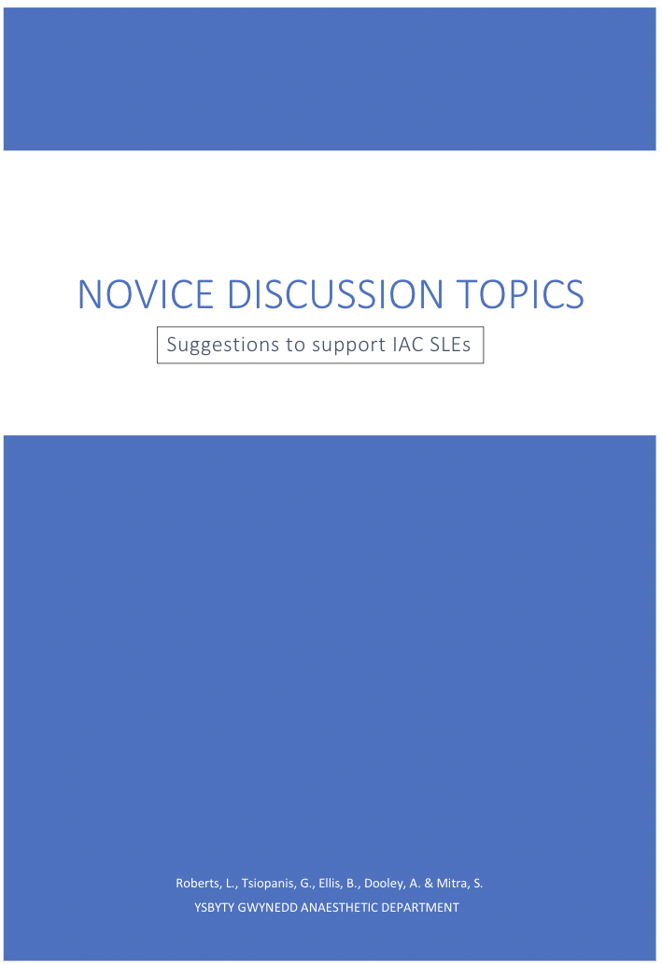
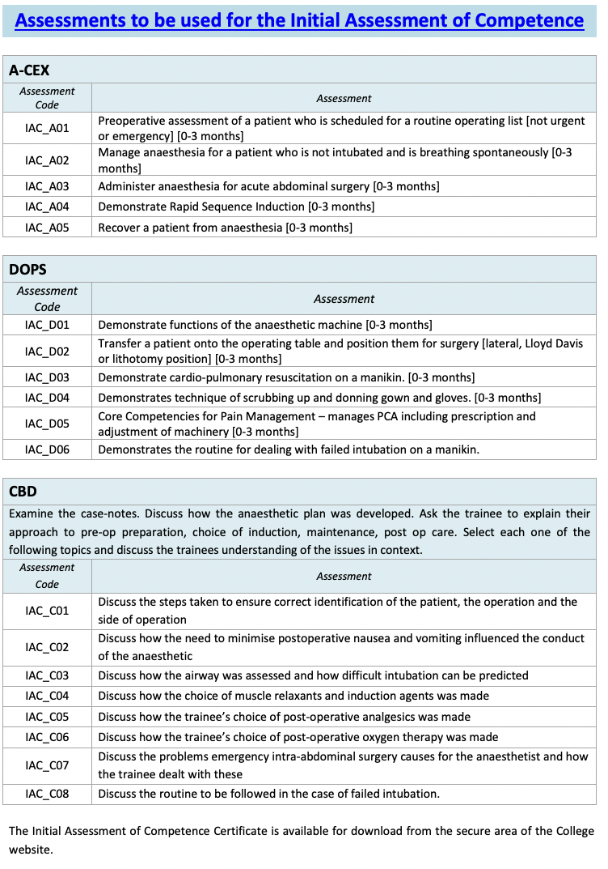
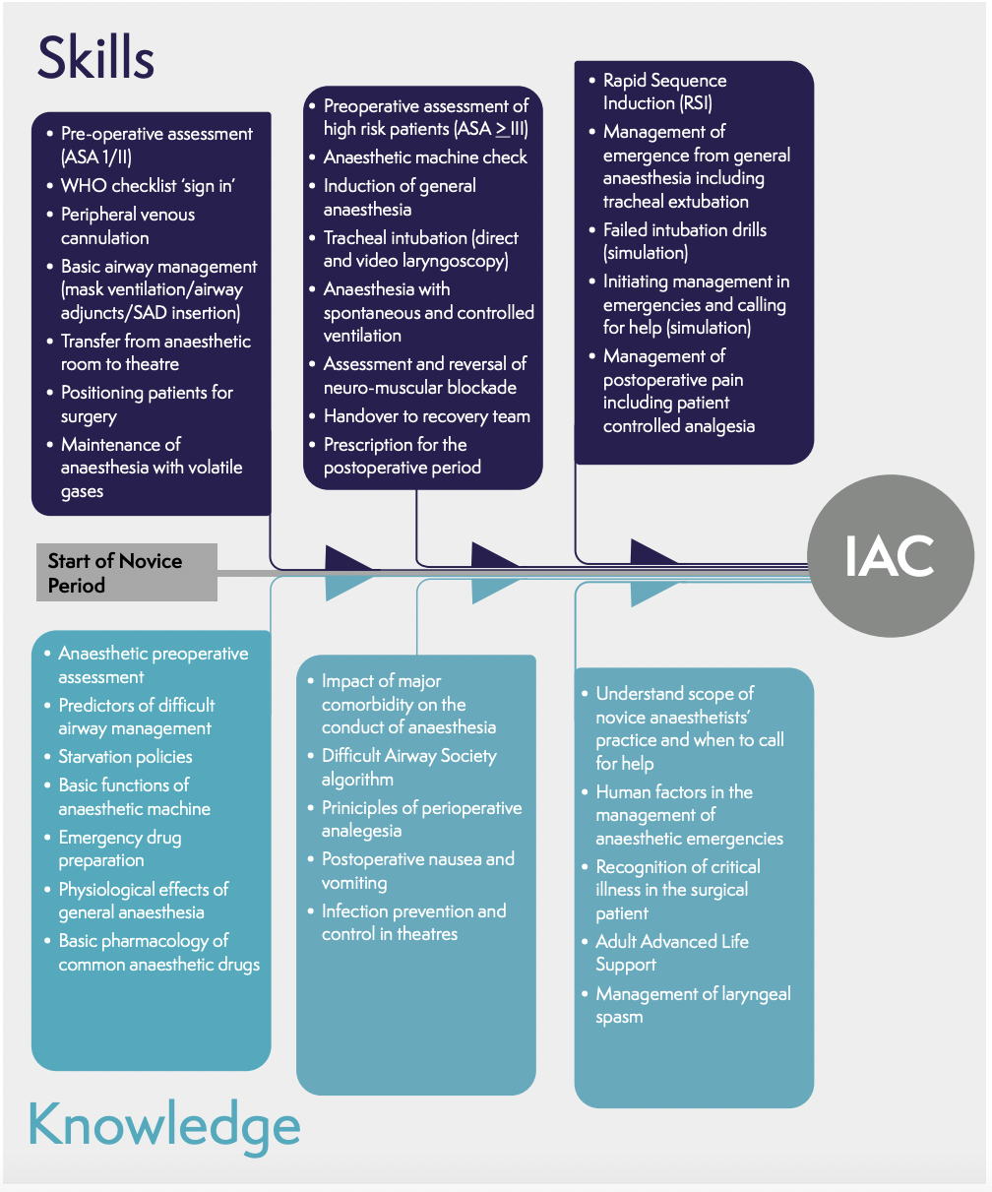
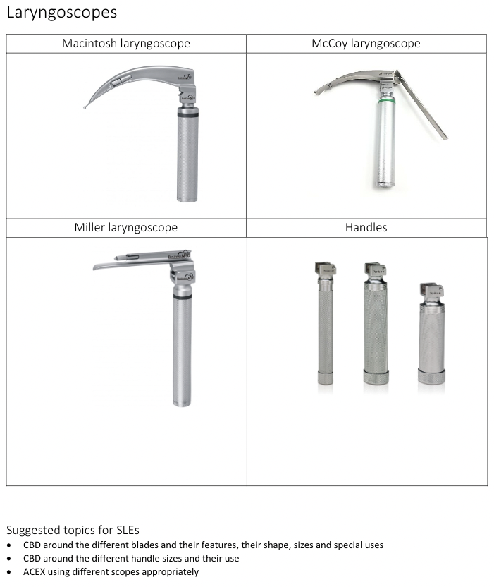
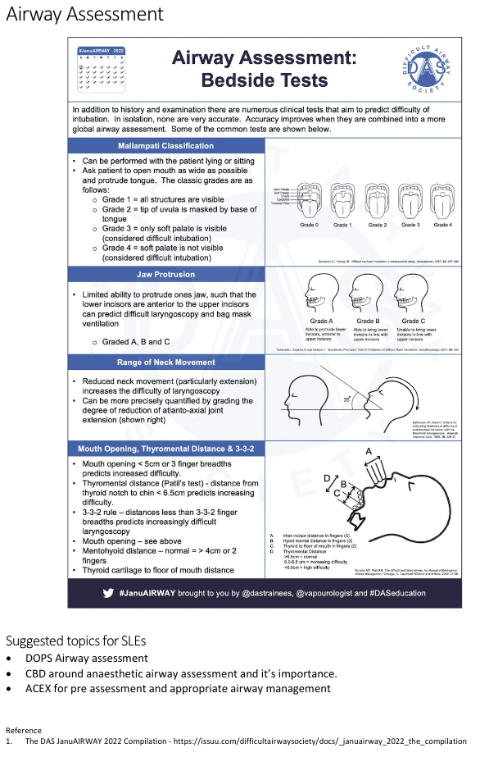
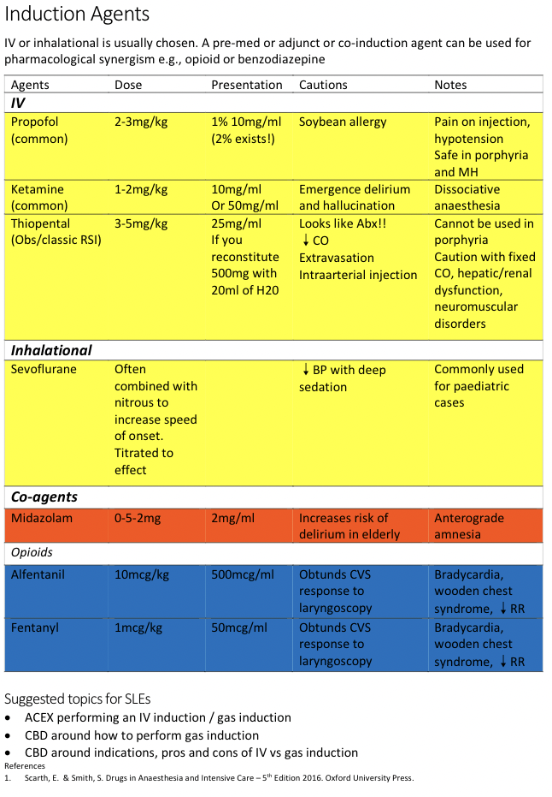
Can We Improve The Experience For The Novice Entering The New Curriculum?
Novice Discussion Topics
Dr L Roberts, Dr B Ellis, Dr G Tsiopanis, Dr S Mitra
Introduction
Following a change in the curriculum from the 2010 RCOA edition to the 2021 edition, there is greater flexibility for the experienced trainee but potentially increased challenges for the ‘new’ novice. The first few months of novice training is challenging, navigating a new hospital, getting familiar with the theatre environment without adding educational challenges.
We felt from experience, and informal feedback that the new novice may benefit from a helping hand, some suggestions of how to create assessments from everyday experiences, meeting the curriculum needs all this by optimising otherwise wasted time. What do we mean by wasted time? The down time in theatre where informal conversation takes place, the theatre time with a supervisor who is less confident in teaching ‘off the cuff’, the lack of continuity with the same supervisor making daily learning objectives difficult to achieve. Turning every theatre encounter into potential SLEs.
2010 and 2021 IAC assessment requirements
Methods
A handbook was designed based on the novice curriculum requirements, this was as a physical paper booklet and pdf document. The document contained ideas and suggestions under three broad categories: equipment, clinical topics and drugs. The booklet deliberately lacks detail, as it should spark discussion and conversation, the detail should be added during the face to face discussion – this is the learning event.
Examples of topics included within the handbook
Results
Initial numbers are small with only three novice trainees rotating, preliminary qualitative feedback is positive. The project is to be continued over the next few rotations to increase the numbers for qualitative evidence as well as being in the process expanded at a health board wide level.
Where the flexibility of the new curriculum can allow you to experience and create SLEs from your experiences rather than creating experiences to fit assessments. However, this requires familiarisation and organisation with regards to creating bespoke assessments, initially this can be burdensome and add significant stress to the trainees’ mental load.
Conclusion
Preliminary feedback is positive supporting the benefit of the handbook.
References
RCOA 2010 Core Training Curriculum – Annex B: https://www.rcoa.ac.uk/sites/default/files/documents/2019-08/TRG-CCT-ANNEXB.pdf
RCOA 2021 Stage 1 Curriculum: https://rcoa.ac.uk/documents/2021-curriculum-learning-syllabus-stage-1/introduction

